Slide 1
Customer Churn Analysis
Improving Customer Retention Through Data-Driven Insights
Boxify Inc.
Presented by : Data Analyst
1,000
Total Customers
13.4%
Churn Rate
26
High Risk
Boxify Inc. | Customer Churn Analysis 1

Slide 2
Executive Summary
Business challenge, objective and expected outcome
⚡ Business Challenge
• Subscription cancellations reduce recurring revenue.
• Churn also reduces potential customer lifetime value.
• Management needs to identify high-risk customers and segments.
🎯 Project Objective
• Understand customer churn behavior.
• Identify high-risk customer segments.
• Measure business impact using churn, CLV and revenue lost.
• Recommend practical retention strategies.
📈 Expected Outcome
• Reduce churn over the next 6 months.
• Increase customer engagement and loyalty.
• Improve customer lifetime value.
• Reduce revenue loss from cancellations.
Boxify Inc. | Customer Churn Analysis 2

Slide 3
Business Understanding & Analytical Approach
🔍 Business Questions
• Which customer segments have the highest churn?
• How does customer engagement influence churn?
• How does CLV differ between active and churned customers?
• Which customers should be prioritized for retention?
• What strategies can reduce future churn?
⚙️ Analytical Process
• 1. Business Understanding
• 2. Data Preparation & Cleaning
• 3. Feature Engineering — Age Group & Risk Level
• 4. KPI Development using DAX
• 5. Power BI Dashboard Development
• 6. Business Insights & Recommendations
Boxify Inc. | Customer Churn Analysis 3

Slide 4
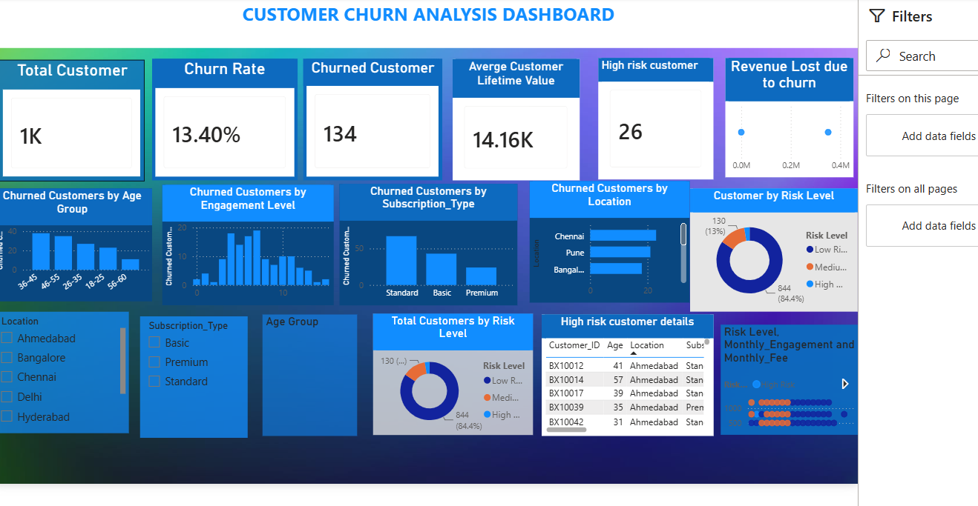
Dashboard Overview
Final Power BI dashboard
Boxify Inc. | Customer Churn Analysis 4

Slide 5
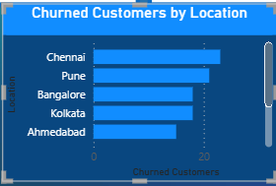
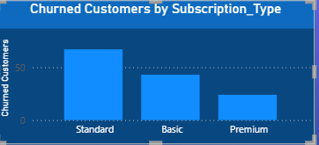
Business Question 1: Which Customer Segments Have the Highest Churn?
📊 Key Findings
• 36–45 has the highest churn rate at 15.6%.
• Standard has the highest subscription-type churn rate at 14.3%.
• Pune has the highest observed location churn rate at 17.6%.
💡 Business Insight
• Segment-specific retention campaigns can be more focused than one-size-fits-all offers.
• Shorter-tenure and monthly customers should be monitored early.
• Location filters can support localized retention actions.
Boxify Inc. | Customer Churn Analysis 5

Slide 6
2. How Does Customer Engagement Influence Churn
29.8%
Low engagement (0–4) churn
8.4%
Higher engagement (8+) churn
💡 Business Insight
• The current dataset shows an inverse relationship: churn tends to be higher at lower engagement.
• Low-engagement customers can be treated as an early-warning segment.
• Onboarding, nudges and re-engagement can be tested for this group.
Boxify Inc. | Customer Churn Analysis 6

Slide 7
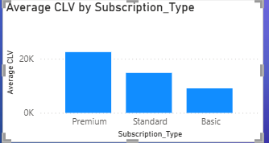
Business Question 3: Customer Lifetime Value & Revenue Impact
₹15,942
Average CLV — Active
₹2,618
Average CLV — Churned
₹350,748
Revenue Lost Due to Churn
💰 Business Insight
• Active customers have higher average CLV than churned customers in the prepared dataset.
• Retention protects both recurring revenue and future customer value.
• CLV should be monitored alongside churn when prioritizing retention efforts.
Boxify Inc. | Customer Churn Analysis 7

Slide 8
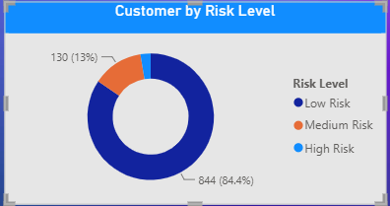
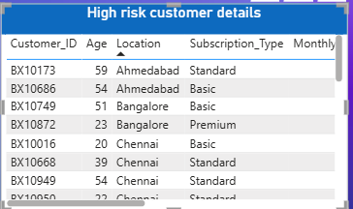
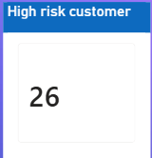
GG FSS
Business Question 4: Identifying Potential Churn Risk

Slide 9
S
4. Identifying Potential Churn Risk
26
High-Risk Customers
2.6%
Share of Customers
100%
High-Risk Group Churn
🤖 Risk Segmentation
• High Risk: Monthly Engagement < 5 AND Duration < 6 months.
• Medium Risk: Monthly Engagement < 8 AND Duration < 12 months.
• All other customers are classified as Low Risk.
• This is a rule-based prioritization framework, not a machine-learning prediction model.
🎯 High-Risk Profile
• Low monthly engagement
• Short subscription duration
• Greater need for early retention intervention
• Customer-level follow-up is available in the dashboard table
Boxify Inc. | Customer Churn Analysis 8

Slide 10
Business Question 5: Customer Retention Strategy
🚀 Immediate Actions
• Personalized email campaigns for high-risk customers.
• Renewal reminders before subscription expiry.
• Re-engagement campaigns for low-engagement users.
• Win-back campaigns for recently churned customers.
🎯 Loyalty & Subscription
• Promote longer-term subscription options.
• Use loyalty rewards for continued subscription.
• Create milestone-based benefits.
• Test monthly-to-longer-plan conversion campaigns.
📈 Long-Term Analytics
• Build a formal churn prediction model with sufficient historical labels.
• Collect customer feedback and exit-survey data.
• Automate risk alerts and retention workflows.
• Track churn, CLV and engagement together.
Boxify Inc. | Customer Churn Analysis 9

Slide 11
Key Business Insights & Recommendations
13.4%
Overall Churn Rate
134
Churned Customers
26
High-Risk Customers
₹14,156
Avg. CLV
📊 Key Insights
• Churn is concentrated in identifiable customer segments.
• Lower engagement is associated with higher churn in this dataset.
• Active customers show higher average CLV than churned customers.
• Risk segmentation provides a practical starting point for proactive retention.
🚀 Final Recommendation
• Prioritize low-engagement, short-tenure customers.
• Use targeted engagement and renewal interventions.
• Encourage longer-term subscriptions where appropriate.
• Monitor churn, engagement, CLV and revenue lost monthly.
Goal: use the dashboard as an ongoing retention-monitoring tool and evaluate campaign impact over the next 6 months.
Boxify Inc. | Customer Churn Analysis 10

